Slide 1
A Computational Model of Afterimages
Tobias Ritschel Elmar Eisemann
Télécom ParisTech (ENST) / CNRS, Paris
Eurographics 2012, Cagliari / Italy, 13—18 May 2012

Slide 2
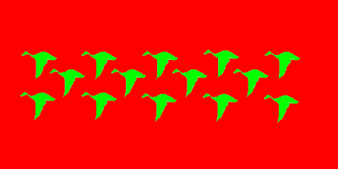
Example

Slide 3
Example

Slide 4
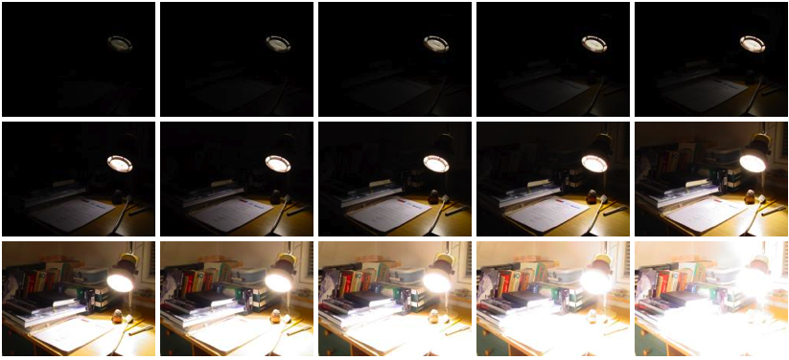
Motivation
Cadik et al.: Evaluation of tone-mapping operatos, Proc. Pacific Graphics (2006)

Slide 5
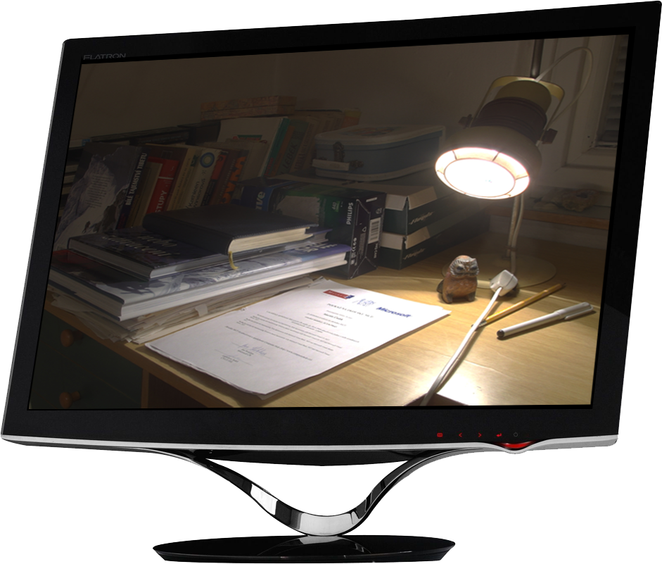
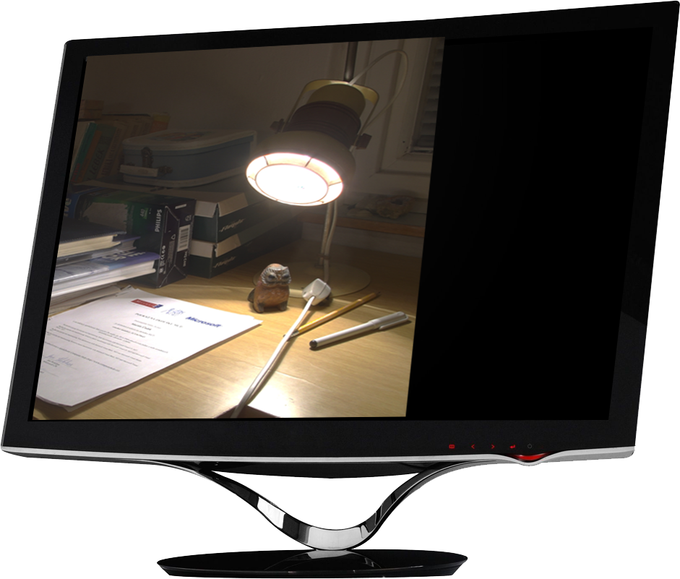
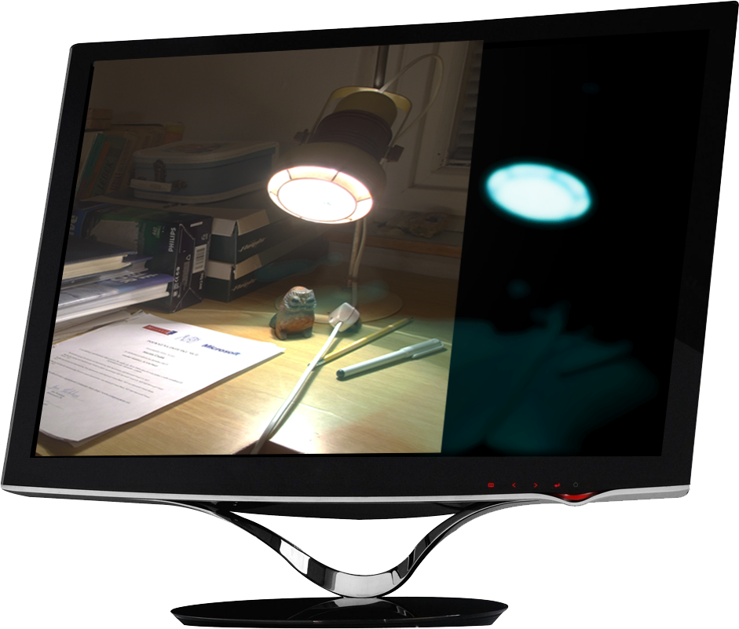
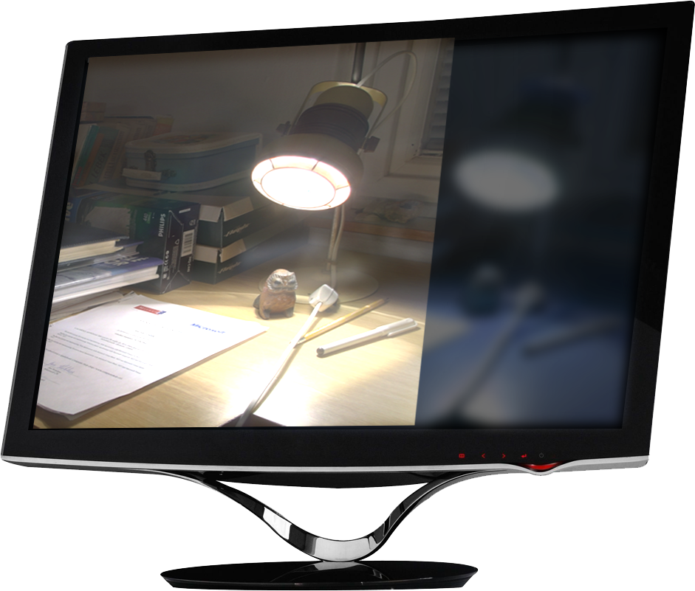
Motivation
HDR image
Changed HDR image
HDR Afterimages
LDR Afterimages
Our Afterimages

Slide 6

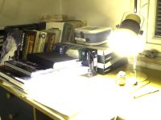
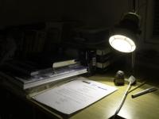
Tone mapping
Division-by-maximum
Clipping
Exponential

Slide 7
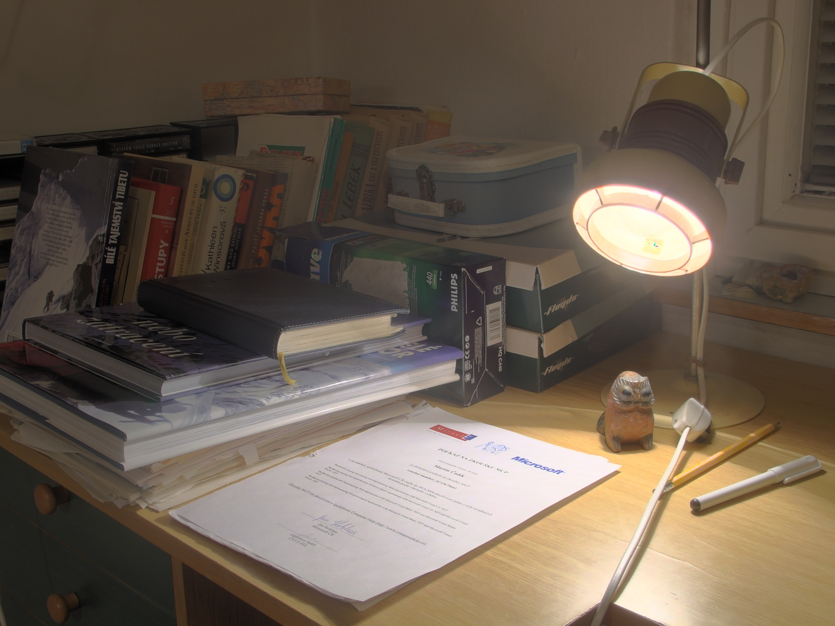
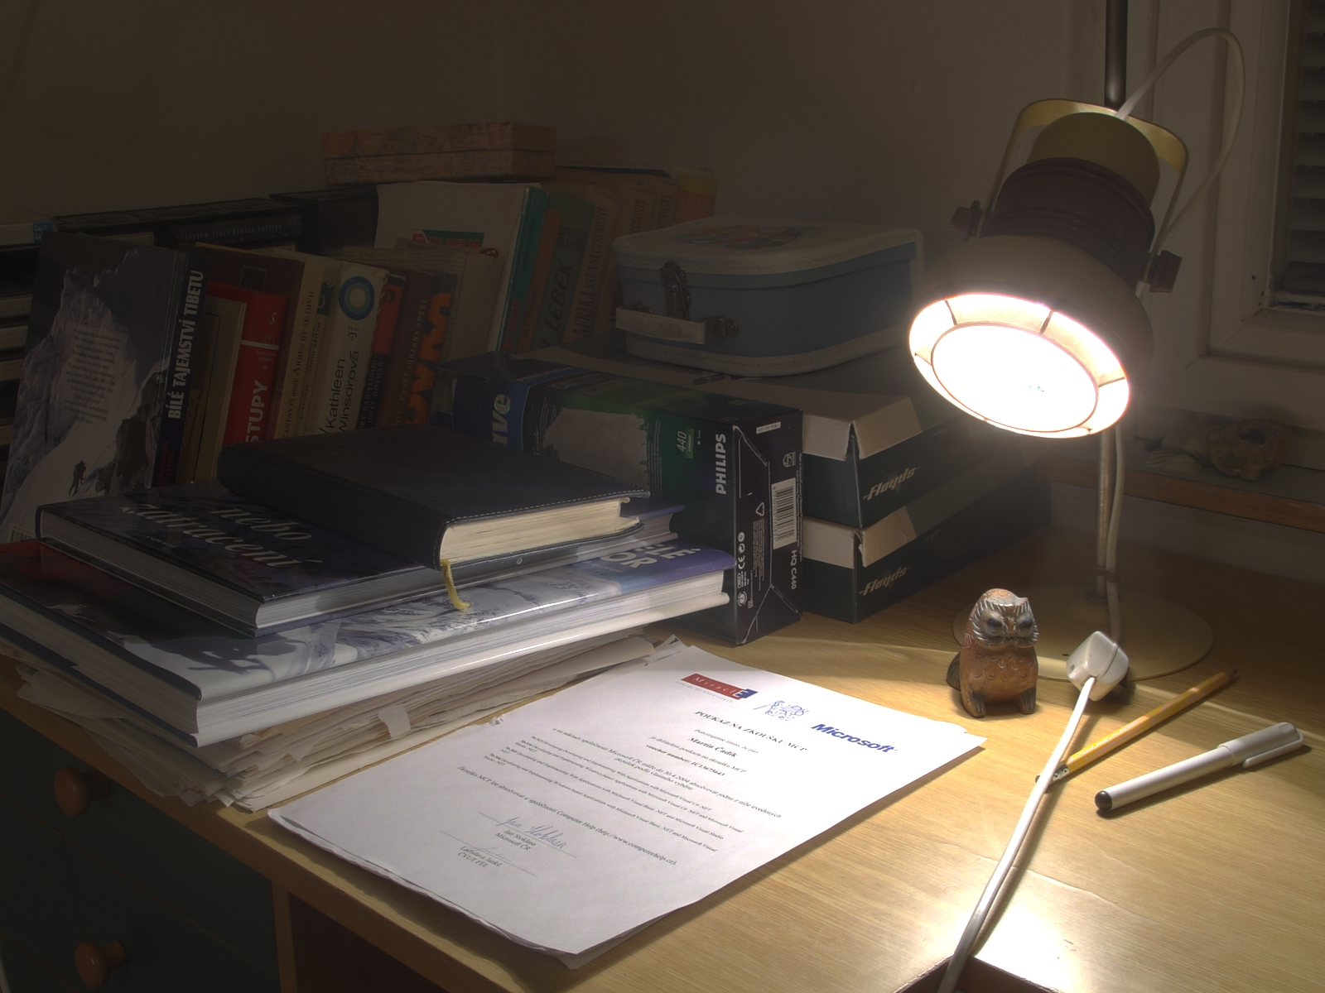
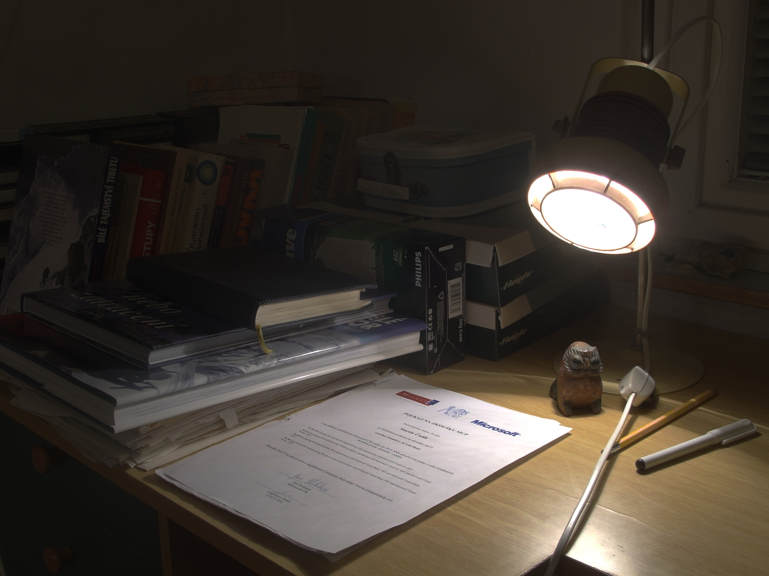
Tonemapping
Ward, 1992
Tumblin & Rushmeier 1993
Ward et al. 1997

Slide 8
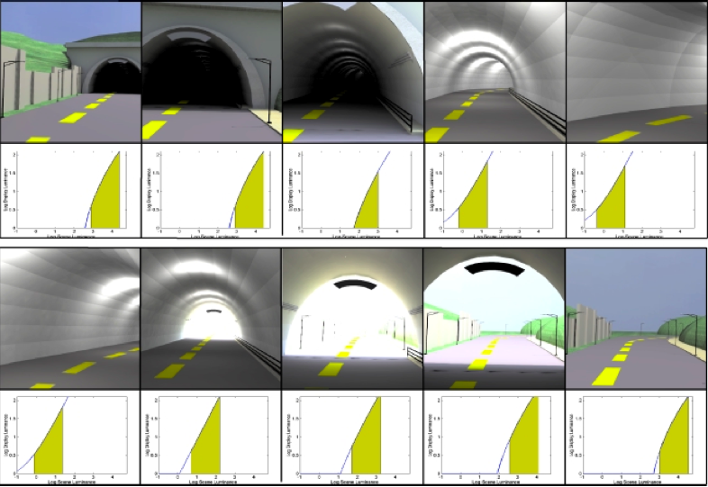
Adaptation
Patanaik et al.: A multiscale model of adaptation and spatial vision for realistic image display, Proc. SIGGRAPH (2000)

Slide 9
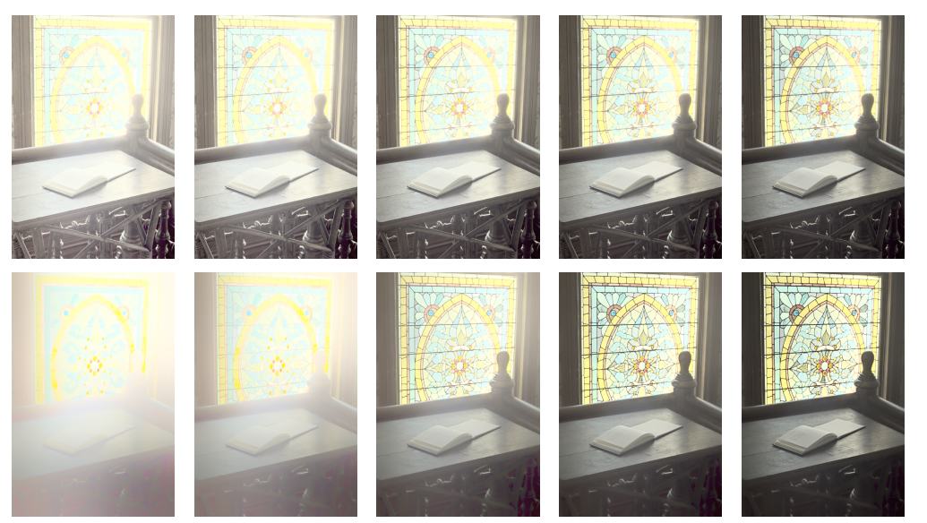
maladaptation
Pajak et al.: Visual maladaptation in contrast domain Proc. SPIE (2010)

Slide 10
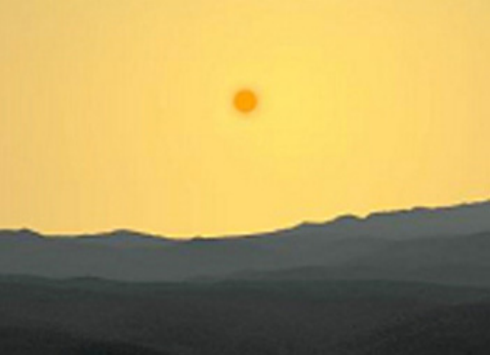
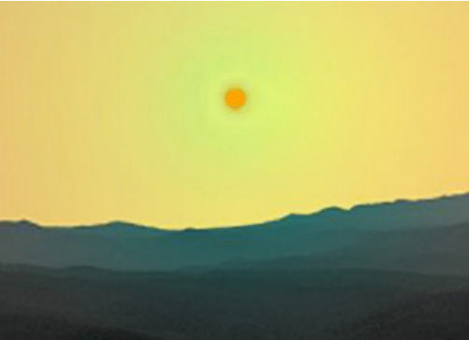
Bleaching
Gutierrez et al.: Perception-based rendering: Eyes wide bleached, Eurographics Short Papers (2005)

Slide 11

Qualitative: Color

Slide 12

Qualitative: Blur 1

Slide 13

Qualitative: Loss

Slide 14

Qualitative: Loss

Slide 15

Qualitative: Loss
Notes:
A more trained artist, can depict brightness even more faithfully.
Here, an animation is used to reproduce an effect that is also included first described in this thesis: bright light sources appear to move.
It‘s important, that natural sciences does not have an explanation for this effect (there is a survey of what is understood so far in the thesis), and computer graphics does not either.

Slide 16
Qualitative: Gain
Long
Medium
Short
Time
Notes:
A more trained artist, can depict brightness even more faithfully.
Here, an animation is used to reproduce an effect that is also included first described in this thesis: bright light sources appear to move.
It‘s important, that natural sciences does not have an explanation for this effect (there is a survey of what is understood so far in the thesis), and computer graphics does not either.

Slide 17
Qualitative: Blur 2
Notes:
A more trained artist, can depict brightness even more faithfully.
Here, an animation is used to reproduce an effect that is also included first described in this thesis: bright light sources appear to move.
It‘s important, that natural sciences does not have an explanation for this effect (there is a survey of what is understood so far in the thesis), and computer graphics does not either.

Slide 18

Qualitative: Blur 2

Slide 19

Qualitative: Blur 2
Notes:
A more trained artist, can depict brightness even more faithfully.
Here, an animation is used to reproduce an effect that is also included first described in this thesis: bright light sources appear to move.
It‘s important, that natural sciences does not have an explanation for this effect (there is a survey of what is understood so far in the thesis), and computer graphics does not either.

Slide 20

Qualitative: Blur 2
Notes:
A more trained artist, can depict brightness even more faithfully.
Here, an animation is used to reproduce an effect that is also included first described in this thesis: bright light sources appear to move.
It‘s important, that natural sciences does not have an explanation for this effect (there is a survey of what is understood so far in the thesis), and computer graphics does not either.

Slide 21
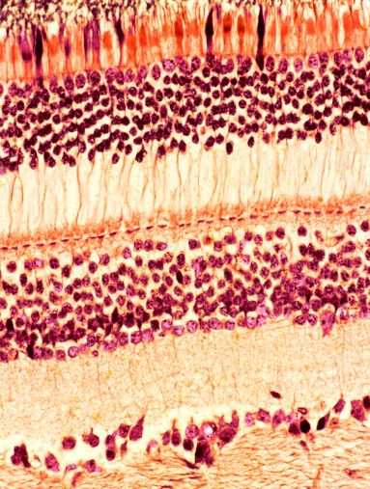
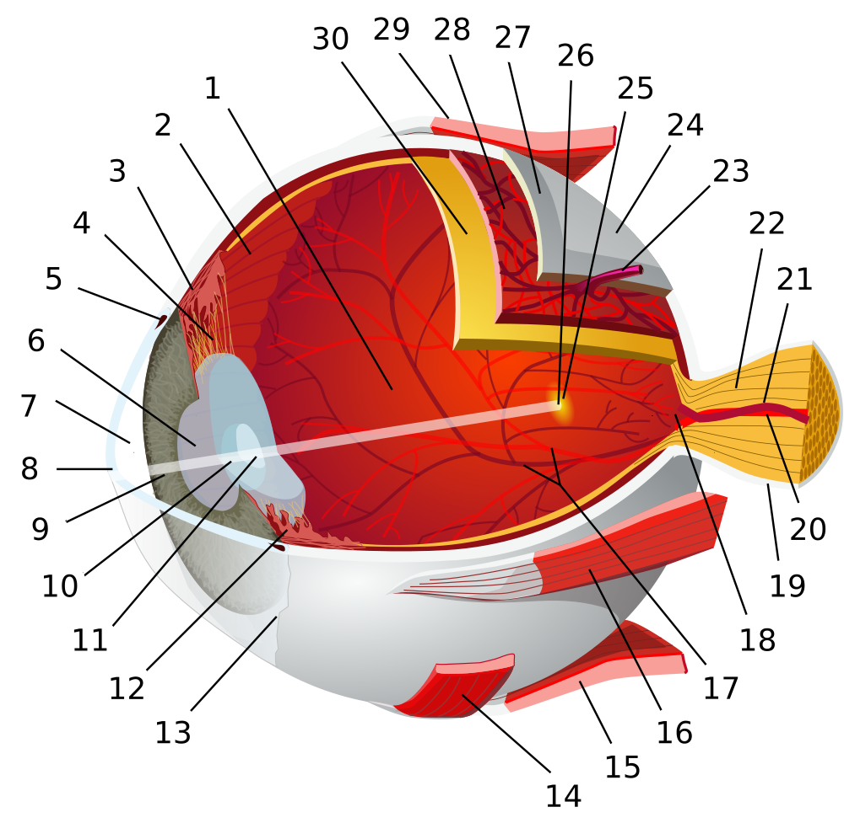
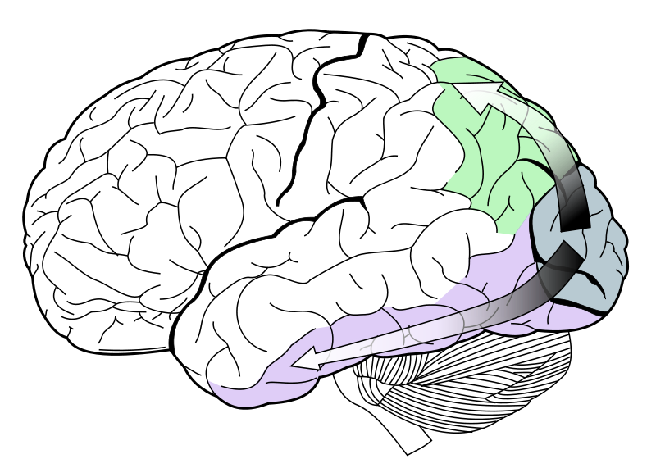
Human Visual System
Retina
Eye
Visual cortex
Notes:
A more trained artist, can depict brightness even more faithfully.
Here, an animation is used to reproduce an effect that is also included first described in this thesis: bright light sources appear to move.
It‘s important, that natural sciences does not have an explanation for this effect (there is a survey of what is understood so far in the thesis), and computer graphics does not either.

Slide 22
Bleaching
Retina
Opsin
Photoreceptor cell
Visual cortex

Slide 23
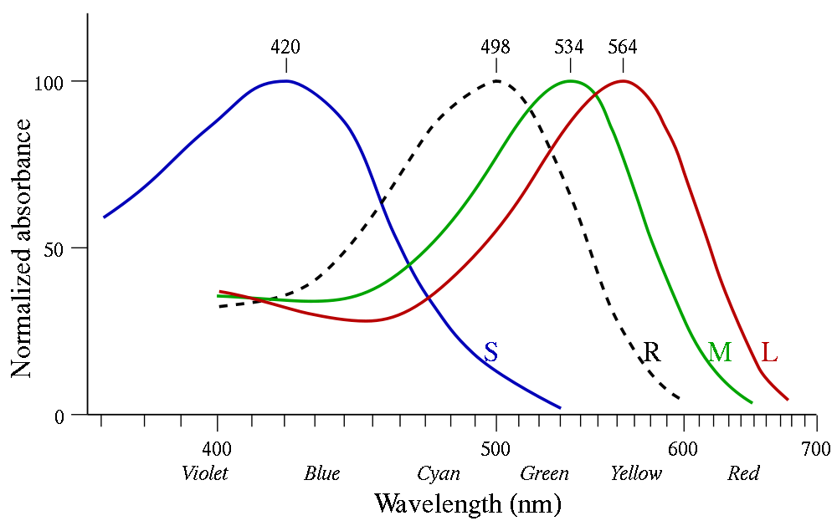
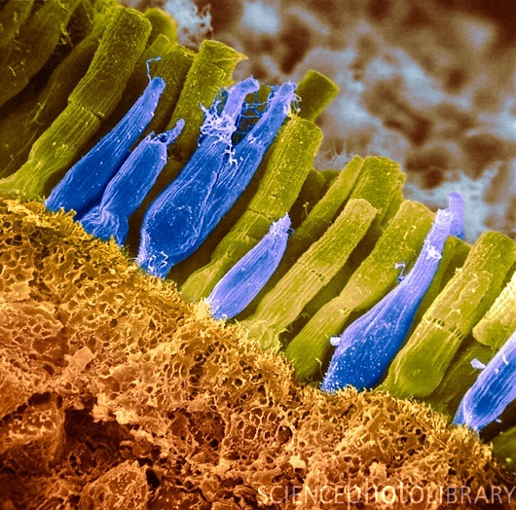
Photoreceptors

Slide 24
Bleaching
Long
(red)
Medium
(green)
Long
(red)
Short
(blue)
Medium
(green)
Pigmentation
Receptor
Visual cortex

Slide 25
Receptor kinetics
r(x, t) Concentration of opsin in space x and time t
Time t
r(0, 0)
r(0, 1)
r(0, 2)
Space x
r(1, 0)
r(1, 1)
r(1, 2)
r(2, 0)
r(2, 1)
r(2, 2)
r(3, 0)
r(3, 1)
r(3, 2)
r(4, 0)
r(4, 1)
r(4, 2)
r(5, 0)
r(5, 1)
r(5, 2)

Slide 26
Receptor kinetics
r(x, t) Concentration of opsin in space x and time t
r(x, t) Change of opsin concentration in space x and time t
Time t
r(0, 0)
r(0, 1)
r(0, 0)
Space x
r(1, 0)
r(1, 1)
r(1, 0)
r(2, 0)
r(2, 1)
r(2, 0)
r(3, 0)
r(3, 1)
r(3, 0)
r(4, 0)
r(4, 1)
r(4, 0)
r(5, 0)
r(5, 1)
r(5, 0)

Slide 27
Receptor kinetics
r(t) Concentration at time t
r(t) Change concentration at time t
L(t) Retinal radiance [Trolands]
Time t
r(0)
r(1)
r(2)
r(0)
r(1)
r(2)
L(0)
L(1)
L(2)

Slide 28
Receptor kinetics
r(t) Concentration at time t
r(t) Change concentration at time t
L(t) Retinal radiance [Trolands]
Time t
r(0)
r(1)
r(2)
r(0)
r(1)
r(2)
Loss
Gain
L(0)
L(1)
L(2)

Slide 29
Receptor kinetics
r(t) Concentration at time t
r(t) Change concentration at time t
L(t) Retinal radiance [Trolands]
Time t
r(0)
r(1)
r(1)
Rel.
Loss
Inv. Rel.
Gain
L(0)

Slide 30
Receptor kinetics
r(t) Concentration at time t
r(t) Change concentration at time t
L(t) Retinal radiance [Trolands]
Time t
r(0)
Low
r(1)
Rel.
Loss
Inv. Rel.
Gain
Low
L(0)

Slide 31
Receptor kinetics
r(t) Concentration at time t
r(t) Change concentration at time t
L(t) Retinal radiance [Trolands]
Time t
r(0)
Low
r(1)
Rel.
Loss
Inv. Rel.
Gain
High
L(0)

Slide 32
Receptor kinetics
r(t) Concentration at time t
r(t) Change concentration at time t
L(t) Retinal radiance [Trolands]
Time t
r(0)
High
r(1)
Rel.
Loss
Inv. Rel.
Gain
Low
L(0)

Slide 33
Receptor kinetics
r(t) Concentration at time t
r(t) Change concentration at time t
L(t) Retinal radiance [Trolands]
Time t
r(0)
High
r(1)
Rel.
Loss
Inv. Rel.
Gain
High
L(0)

Slide 34
Receptor kinetics
r(t) Concentration at time t
r(t) Change concentration at time t
L(t) Retinal radiance [Trolands]
r(0)
Low
L(0)
Low
r(1)
r(0)
Low
L(0)
High
r(1)
r(0)
Low
L(0)
High
r(1)
r(0)
High
L(0)
High
r(1)
r(x, t) = c_{a} L(x, t)(1- r(x,t)) – c_{d} r(x,t)

Slide 35
Why kinetics?
Time t
r(0)
r(1)
r(2)
r(0)
r(1)
r(2)
Afterimages
L(0)
L(1)
L(2)
Forces (Gravity, …)
f(0)
f(1)
f(1)
Position
p(1)
p(2)
Animation
p(0)
Speed
p(2)
p(0)
p(1)

Slide 36
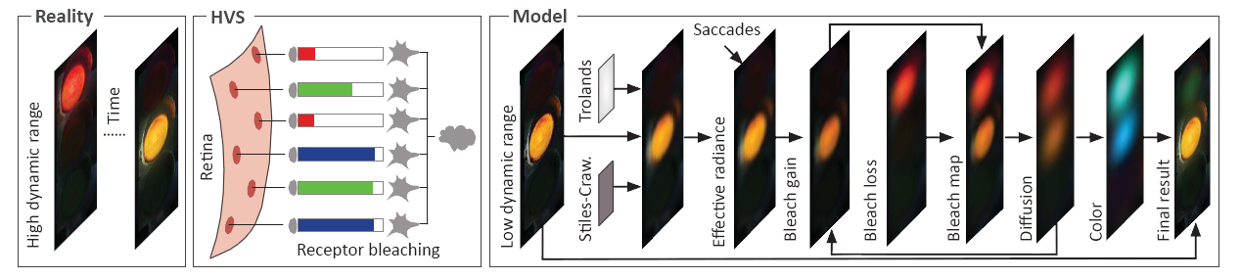
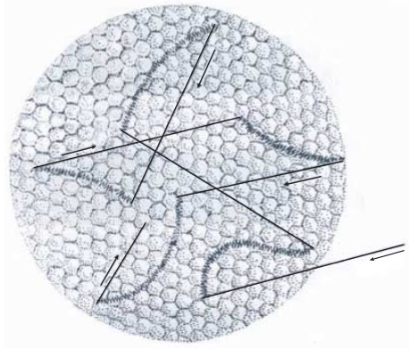
Effective radiance
Martinez-Conde et al.: The role of fixational eye movements in visual perception. Nature Rev. Neurosc. 5(3), 2004

Slide 37
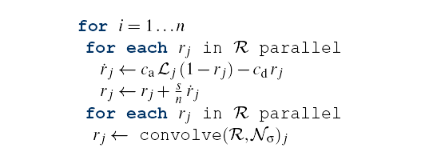
(GPU) Solver

Slide 38
Diffusion

Slide 39
Compositing

Slide 40
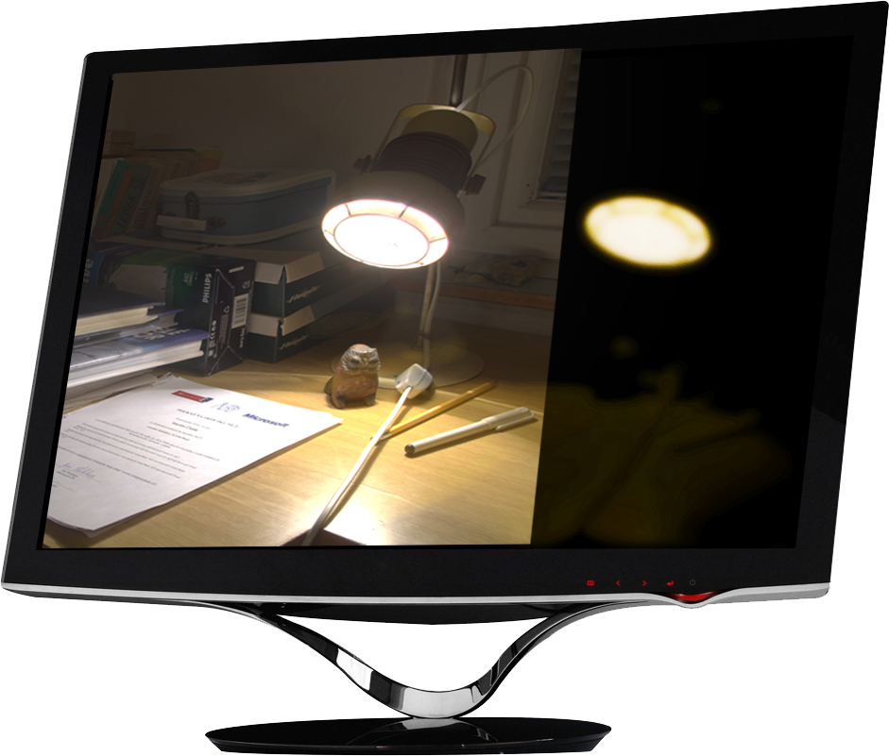
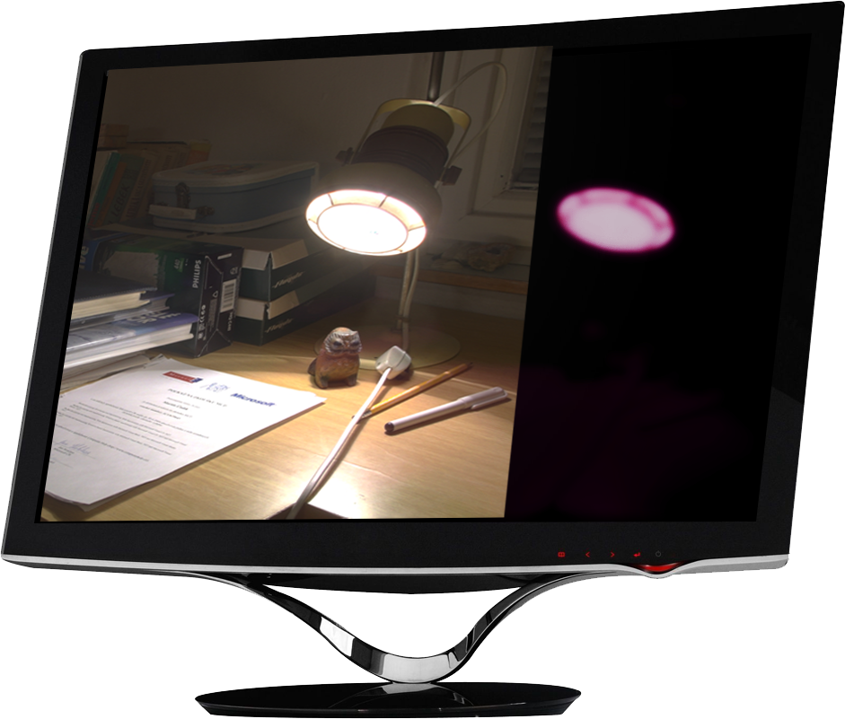
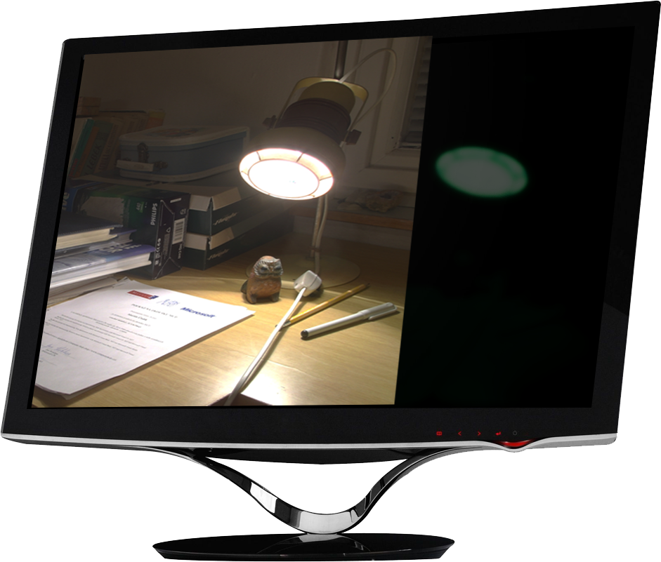
Flight of colors
Shuey: The flight of colors. Am J Psych 35(4)
Notes:
Philosophical implications: Introspection

Slide 41
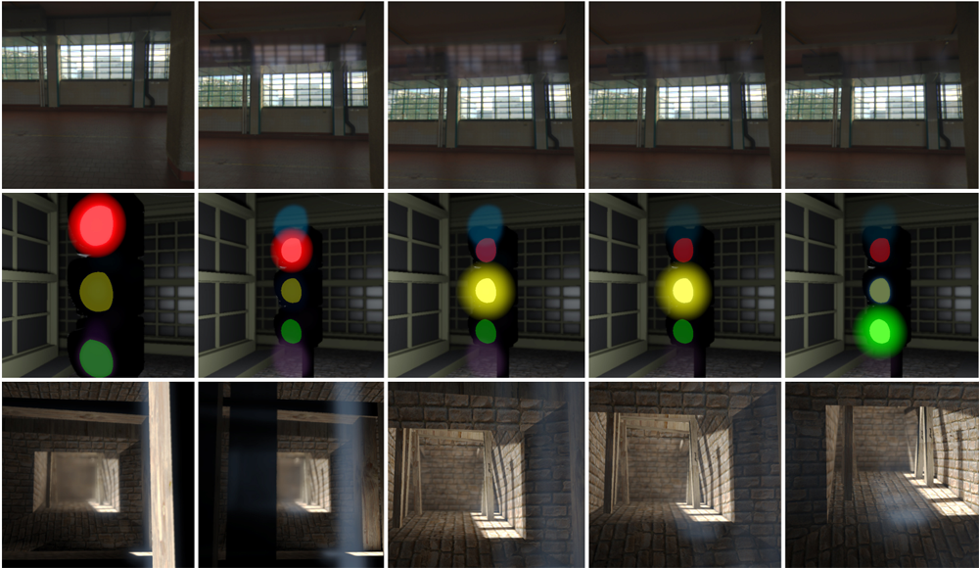
Results

Slide 42
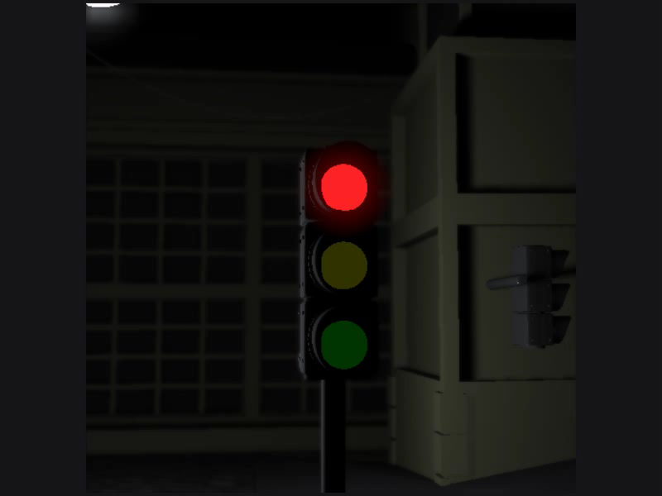

Slide 43
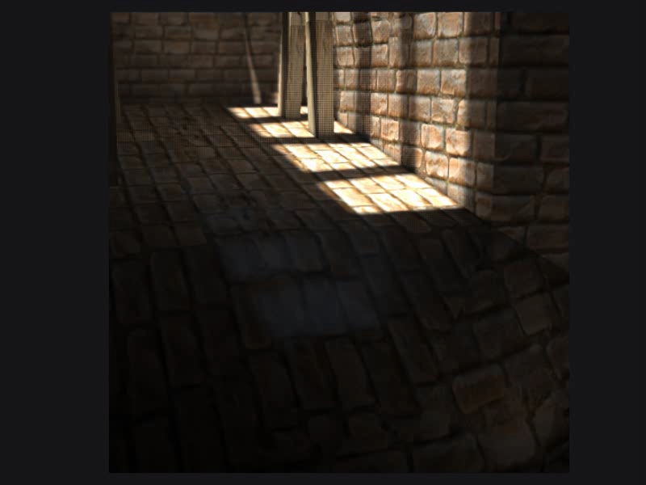

Slide 44
Study 1
Samsung RZ 2233 display
120 Hz 1680 x 1920
250 cd/m² (high)

Slide 45
Study 1
2-Answer forced-choice
Two circular patches
200 ms

Slide 46
Study 1
Afterimages close-to-threshold:
Get faint very quick

Slide 47
Study 1
Result
9 subjects
2700 trials
57.3 % Afterimages was brighter
(Significant, but …)

Slide 48
Study 2
Adjustment
Two circular patches
200 ms

Slide 49
Study 2
Afterimages close-to-threshold:
Get faint very quick

Slide 50
Study 2

Slide 51
Study 2
Result
6 subjects
42 trials
Avg. factor 1.83
Std. dev. 0.23

Slide 52
Conclusion
Computational model of afterimages
Empirical but also well-grounded in retinal kinetics
A simple shader with a texture
Study to validate that it is perceived brighter
Future work:
Eye tracking
Proper colors
More after-effects

Slide 53
Thank you!
Acknowledgements
Hans Brettel
Tamy Boubekeur
Martin Cadik
David Pajak
Karol Myszkowski
Sirko Straube
Télécom ParisTech
Télécom ParisTech
MPI Informatik
Nvidia
MPI Informatik

